Slide 1
Plagiarism Checker
Paarth Sarathi
CSE5A
209301046

Slide 2
Objective
To check for plagiarism - check the percentage of text that is similar between 2 or more files.

Slide 3
Project Statement
User has to put the files in the same folder as the program.
The program is capable of comparing any number of files in pairs.
Number of combinations is nC2 where n is the number of files.
For example: if 5 files are present, there will be 10 comparisons.

Slide 4
How it Works
The Program uses advanced machine learning algorithm to vectorize each word of every file present in the same folder as the program ending with ‘.txt’.
Vectorizing words let’s us compare their numerical vector values to determine their similarity.
The output shows the percentage of similarity between the pair of files. 1 being exact copy whereas 0 being nothing in common.

Slide 5
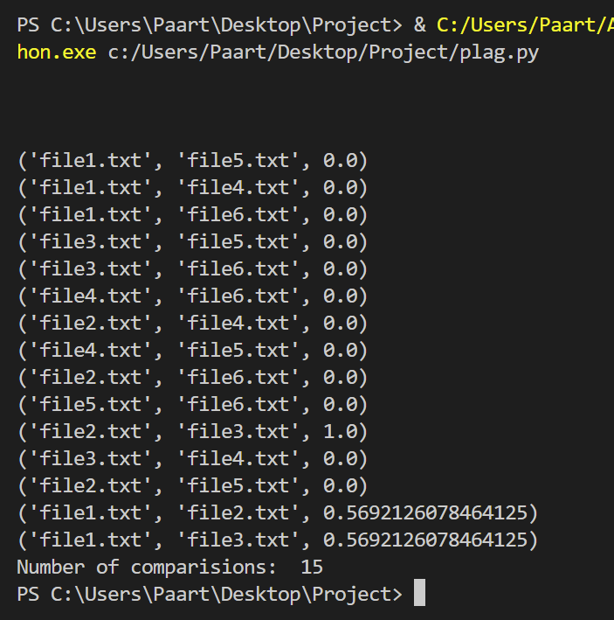
Output
Number of files: 6

Slide 6
IDE and Software Used
IDE: Visual Studio Code
Programming Language: Python
Machine learning algorithms: scikit learn

Slide 7
Links
GitHub Link: https://github.com/paarthsarathi/Plagiarism_Project
One Drive Link: Plagiarism Project

